Slide 1
Cross-entropy method (Main reference: Chapter 4 of (Lapan, 2020))

Slide 2
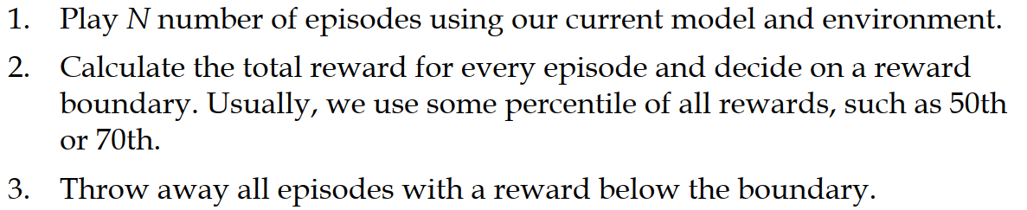














Cross-entropy method
Source: (Lapan, 2020)

Slide 3
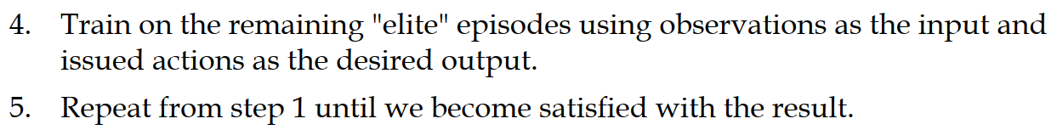










Cross-entropy method
Source: (Lapan, 2020)

Slide 4
Revisit the CartPole environment
https://gym.openai.com/envs/CartPole-v1/

Slide 5















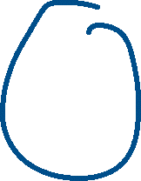


Neurons and Neural networks
Animation of a neuron: https://appliedgo.net/perceptron/

Slide 6
















Slide 7












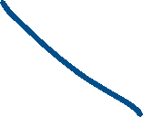

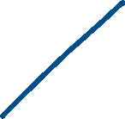


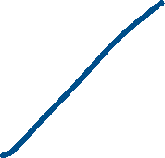






Installation of Cross entropy method

Slide 8
Use Monitor wrapper class

